Slide 1

Carbon CREDIT Exchange
Project Proposal
Saim Zuberi.

Slide 2
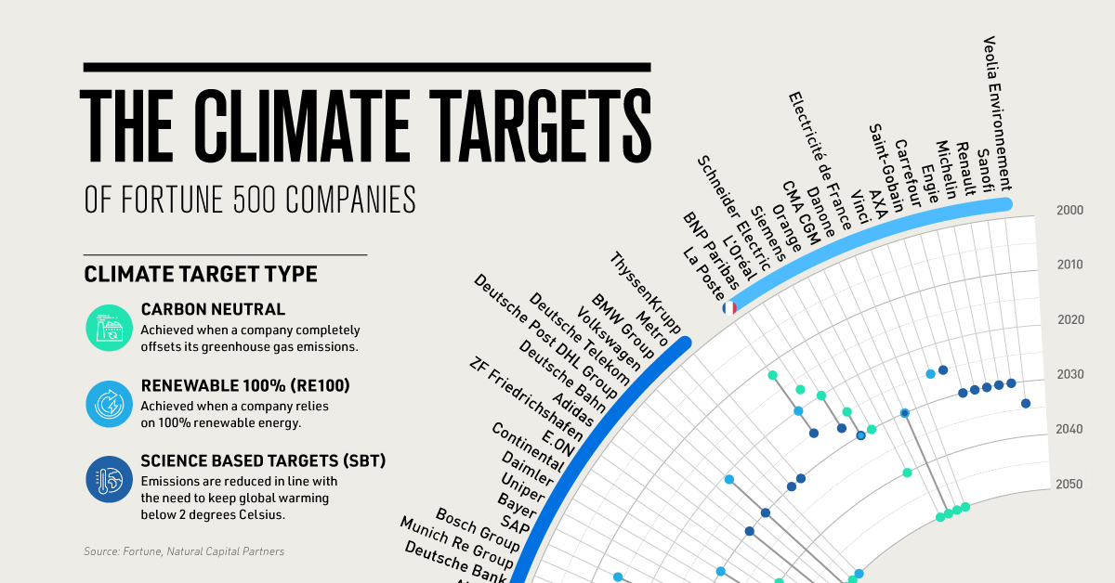
Exposure to carbon credits may be the best investment of the next decade
One of the biggest business success stories in the last decade has been Elon Musk led Tesla. But it may come as a surprise to many that Tesla didn’t become the powerful institution it is with its EV sales alone. Even with a well performing last quarter, a considerable share of its revenue came from regulatory (carbon) credits - this after a jump of 116% in its carbon credit sales earlier this year.
Carbon credits contributed substantially to the company’s in 2020 In fact in 2021 Tesla reportedly earned more from credits and bitcoin than cars.
Tesla is one among a few companies that have recognized the potential for a carbon credit market early. The Taskforce on Scaling Voluntary Carbon Markets (TSVCM) and McKinsey estimate that demand for carbon credits could increase by a factor of 15 or more by 2030 and by a factor of up to 100 by 2050. Overall, the market for carbon credits could be worth upward of $50 billion in 2030. The evidence of the increasing cost of carbon credits is significant. For instance, European carbon prices broke above €98 a tonne for the first time ever, after gas prices returned to record levels, resulting in higher emissions and demand for permits.

Slide 3
Voluntary Carbon Markets in Blockchain
Governments engage with the VCM by instituting policies, regulations, and safeguards that influence VCM activities, creating enabling environments that facilitate VCM projects or programs, and sponsoring VCM projects or programs within their territories.
The VCM is governed by private standards and not by international or national regulatory bodies. However, projects and programs developed under the VCM may support countries in achieving their commitments under the Paris Agreement.
A carbon credit is a tradable unit that represents one ton of greenhouse gas (GHG) emissions reductions or removals. Carbon credits in the VCM are generated by the activities of projects and programs that are certified by standards.
The credits are purchased by companies, individuals, and other entities to offset GHG emissions or otherwise contribute to emissions abatement. The prices of carbon credits are determined by the types and quality of VCM activities and the demand for credits from those activities.

Slide 4
Components of Carbon Exchange
High Quality Carbon Credit Projects Registeration
Carbon Standard
Carbon Credits
Exchange
Nature-based solutions (NbS) are actions to protect, sustainably manage, and restore ecosystems with their benefits for humans and nature.. NbS could deliver about one-third of the emission reductions and removals needed to keep warming below 1.5°C
Carbon standards are central to the operation of the VCM. Carbon standard organizations provide and administer the rules and requirements for VCM projects and programs, certify and issue carbon credits, and facilitate the trade in carbon credits.
Carbon credits are tradable, certified greenhouse gas (GHG) emission reductions or removals. Carbon standards issue carbon credits to registry accounts.
Tokenization of Carbon NbS
Evaluation of Carbon Standard
Buying and buying of carbon credit

Slide 5
Components – Though process
dApp for registering a NbS project.
Using Solidity for Registering Projects of Blockchain
Stremlit for Frontend
dApp for evaluation of NbS project and Tokenization.
Using Solidity for Tokenization of Project already registered against a contract
Using front end to evaluate the impacts of the project and allocating carbon credits against it and setting pricing
Buying of the Carbon Credit Tokens using dApp.
Using Metamask wallets to buy token

Slide 6
Structure
Streamlit Application
Streamlit Application
Streamlit Application
Crowd Sales Engine
NbS Projects
Fungible and
Non Fungible Tokens

